Slide 1
Chapter 1
Introduction to Operating Systems

Slide 2
Objectives
Operating System (OS)
The evolution of Operating Systems
Batch processing systems
Multiprogramming systems
Multiuser systems
Multitasking systems
Multiprocessor systems
Distributed systems
Real time systems
Embedded systems
Goals of an operating system
Functions of Operating systems
Generic components of operating systems

Slide 3
Operating System
Operating System is a software, which makes a computer to actually work.
It is the software the enables all the programs we use.
The OS organizes and controls the hardware.
OS acts as an interface between the application programs and the machine hardware.
Examples: Windows, Linux, Unix and Mac OS, etc.,

Slide 4
Operating System Structure
Application Programs
System Programs
Software (Operating System)
HARDWARE
(Contd…)

Slide 5
Operating System Structure
The structure of OS consists of 4 layers:
Hardware
Hardware consists of CPU, Main memory, I/O Devices, etc,
Software (Operating System)
Software includes process management routines, memory management routines, I/O control routines, file management routines.
System programs
This layer consists of compilers, Assemblers, linker etc.
Application programs
This is dependent on users need. Ex. Railway reservation system, Bank database management etc.,

Slide 6
Definition of OS
Operating systems exist to offer a reasonable way to solve the problem of creating a usable computing system.
The fundamental goal of computer systems is to execute user programs and to make solving user problems easier.
Since bare hardware alone is not particularly easy to use, application programs are developed.
These programs require certain common operations, such as those controlling I/O devices.
The common functions of controlling and allocating resources brought together into one piece of software: the operating system.

Slide 7
Evolution of Operating Systems
Generation | Period | Computer architecture | Problems and development of Operating systems
First | 1940s–1950s | Vacuum tubes based technology, plug boards and punched cards, magnetic core memories | No operating system

Slide 8
Evolution of Operating Systems
Generation | Period | Computer architecture | Problems and development of Operating systems
Second | 1950s–1960s | Transistors based technology, Mainframe computers, line printers, magnetic tapes, assemblers, linkers, loaders, compilers, FORTRAN, COBOL | Set up delay problem due to loading and unloading of tapes in earlier computer systems. CPU was idle. Jobs of users prepared with same programming language were batched together. Automated job sequencing Resident monitor Batch systems Mismatch between the speed of CPU and I/O devices Offline operation with magnetic tapes Tapes were sequential access devices

Slide 9
Evolution of Operating Systems
Generation | Period | Computer architecture | Problems and development of Operating systems
Third | 1960s–1980s | IC based technology, Minicomputer Magnetic disk | Hard disks came into existence Spooling Multi-programming Multi-programmed batch systems Lack of user/programmer interaction with their jobs in multi-programmed batch systems Timesharing multiuser systems CTSS MULTICS UNICS UNIX Unix written in C

Slide 10
Evolution of Operating Systems
Generation | Period | Computer architecture | Problems and development of Operating systems
Fourth | 1980s–Present | LSI and VLSI based technology, Microcomputer | CP/M for PCs MS-DOS Multiuser facilities were not there in DOS XENIX OS/2 No user friendliness and convenience due to command driven and complex file systems Windows Multitasking Multithreading Network operating systems Distributed operating systems

Slide 11
Types of Operating System
Type of operating system | Features/benefits | Example | Applicable to which type of application
Batch systems | More than one job can be stored in main memory Batches of same type of jobs can be executed quickly | FMS (FORTRAN monitor system), IBM’s operating system for 7094 | Background jobs in which the user interaction is not necessary
Multiuser systems | Jobs of different users who are connected to a main computer are executed through the multiprogramming Interaction of jobs with the user is possible Debugging is easy | CTSS by MIT, TSS by IBM, MULTICS, UNIX | When multiple users need to share a single system

Slide 12
Types of Operating System
Type of operating system | Features/benefits | Example | Applicable to which type of application
Multitasking systems | Multiple tasks of a single user can be opened on the system through multiprogramming | Windows | When a user wants to open and work simultaneously on many windows on the system
Real-time systems | Used to handle time-bound responses to the applications | pSOS, VxWorks, RTLinux, etc. | Applicable to systems which require time-bound response, i.e., for the real-time processing systems

Slide 13
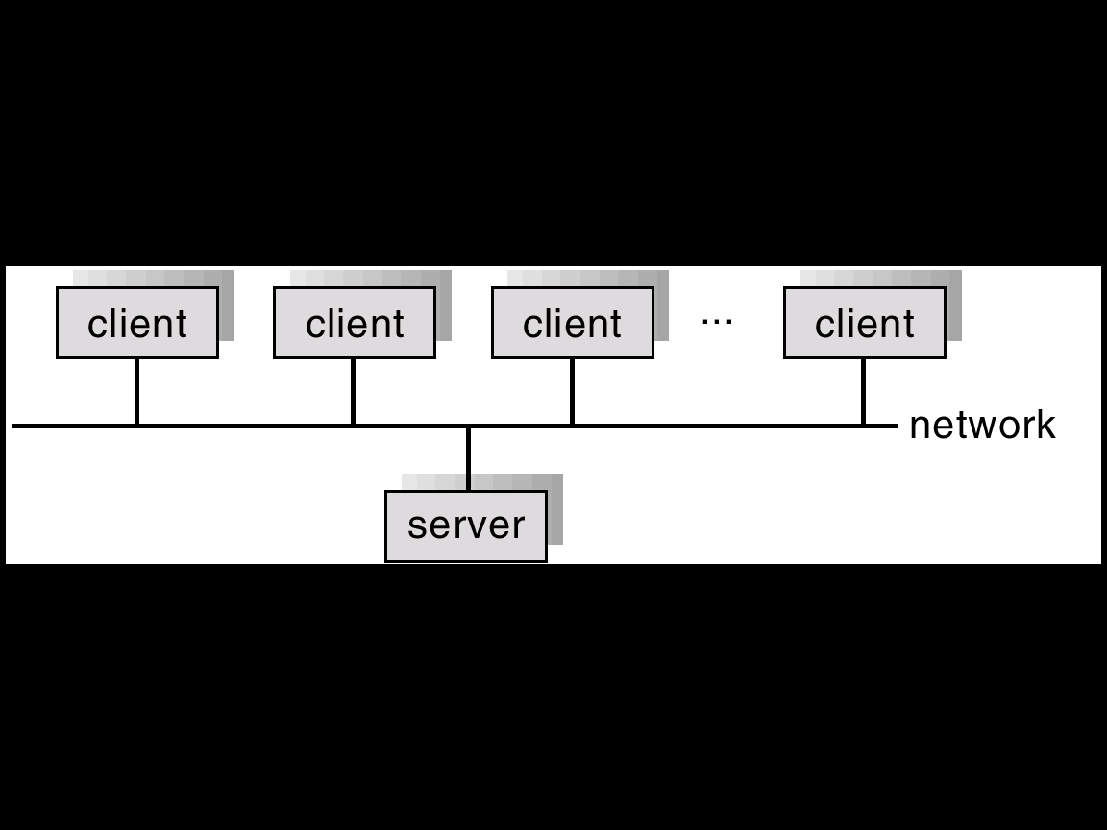
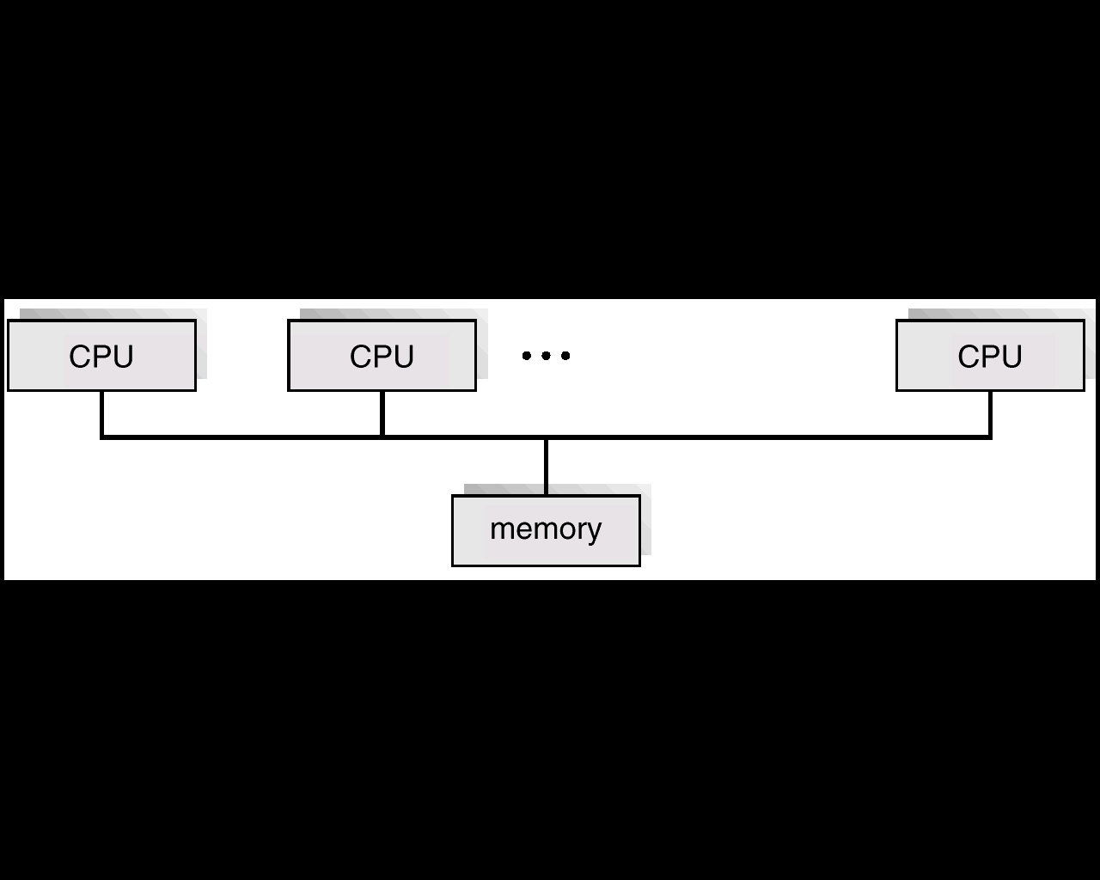
Types of Operating System
Type of operating system | Features/benefits | Example | Applicable to which type of application
Distributed systems | When multiple nodes of a wide network realized as a powerful machine sharing the resources on the network. The users are not aware where their processes are being sent and executed. | Amoeba, V system, Chorus | When computational speed and resource sharing is required and implemented through various full computer systems in a network
Network systems | The user is able to connect to another machine and perform many operations The user is aware of the location of the network node where he/she wants to connect | Novell Netware, Windows NT, Windows 2000, Windows XP, Sun Solaris | When a user wants to remote login on a system, wants to transfer a file, etc. on a network system

Slide 14
Types of Operating System
Type of operating system | Features/benefits | Example | Applicable to which type of application
Embedded systems | Specialized systems with size, memory and power restrictions | Palm Pilot, Toshiba Pocket PC, Palm OS, Symbian OS, iPhone OS, RIM’s BlackBerry, Windows Phone, Linux, Palm WebOS, Android and Maemo. | Used in consumer electronics items, mobile phones, smart cards, etc.

Slide 15
Convenience Hardware abstraction/Virtual machine Convenient programming environment Response time Easy to use interface Resource utilization/management Protection
Goals of an Operating System

Slide 16
User view User Interface Program development and execution Accessing I/O operations Accessing File systems Error detection System view
Views of Operating system

Slide 17
User View
Single user computers (e.g., PC, workstations). Such systems are designed for one user to monopolize its resources. The goal is to maximize the work (or play) that the user is performing. The operating system is designed mostly for ease of use and good performance.
• Multi user computers (e.g., mainframes, computing servers). These users share resources and may exchange information. The operating system in such cases is designed to maximize resource utilization to assure that all available CPU time, memory, and I/O are used efficiently and that no individual users takes more than their air share.

Slide 18
User View (Contd..)
Handheld computers (e.g., smartphones and tablets). The user interface for mobile computers generally features a touch screen. The systems are resource poor, optimized for usability and battery life.
• Embedded computers (e.g., computers in home devices and automobiles) The user interface may have numeric keypads and may turn indicator lights on or off to show status. The operating systems are designed primarily to run without user intervention.

Slide 19
System View
System View:
Resource Manager – manages and allocates resources.
Control program – controls the execution of user programs and operations of I/O devices.
Command Executer – Provides an environment for running user commands.
But one more modern view: the Operating System as a Virtual Machine.

Slide 20
1. Resource Manager
Resource Manager:
Manages and protects multiple computer resources: CPU, Processes, Internal/External memory, Tasks, Applications, Users, Communication channels, etc…
Handles and allocates resources to multiple users or multiple programs running at the same time and space (e.g., processor time, memory, I/O devices).
Decides between conflicting requests for efficient and fair resource use (e.g., maximize throughput, minimize response time).
Sort of a bottom-up view.

Slide 21
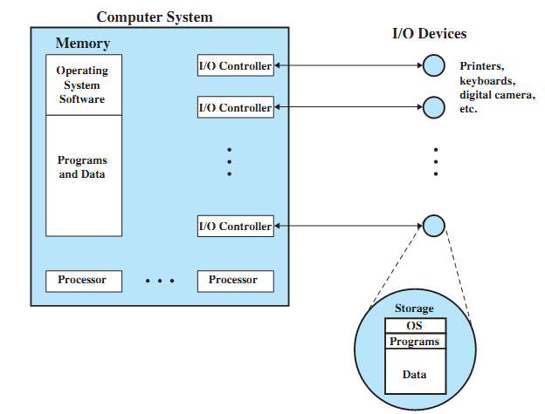
OS as a Resource Manager

Slide 22
Resource Manager oriented OS names
DEC RSX – Resource Sharing eXecutive
MIT Multics – MULTiplexed Information and Computing Services
IBM MFT/MVT – Multiple Fixed/Variable Tasks
IBM MVS – Multiple Virtual Storage
DEC VMS – Virtual Memory System
MVS TSO – Time Sharing Option
CTSS – Compatible Time Sharing System
IBM VM – Virtual machine

Slide 23
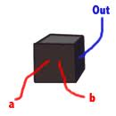
2. Control Program
Control Program:
Manages all the components of a complex computer system in an integrated manner.
Controls the execution of user programs and I/O devices to prevent errors and improper use of computer resources.
Looks over and protects the computer: Monitor, Supervisor, Executive, Controller, Master, Coordinator ….
Sort of a black box view.

Slide 24
Control program oriented OS names
Unisys MCP – Master Control Program
DR CP/M – Control Program/Microcomputer
IBM VM/CP – VM Control Program
IBM AIX – Advanced Interactive eXecutive
DEC RSX – Resource Sharing eXecutive

Slide 25
3. Command Executer
Command Executer:
Interfaces between the users and machine.
Supplies services/utilities to users.
Provides the users with a convenient CLI (Command Language Interface), also called a Shell (in UNIX), for entering the user commands.
Sort of a top-down view.

Slide 26
Command Executer oriented OS names
IBM AIX – Advanced Interactive Executive
IBM VM/CMS – Conversational monitor System

Slide 27
Modern view: Virtual Machine (1)
Operating System as a Virtual Machine:
An interface between the user and hardware that hides the details of the hardware (e.g., I/O).
Constructs higher-level (virtual) resources out of lower-level (physical) resources (e.g., files).
Definition: OS is a collection of software enhancements, executed on the bare hardware, culminating in a high-level virtual machine that serves as an advanced programming environment.
virtual machine = software enhancement = extended machine = abstract machine = layer = level = ring.

Slide 28
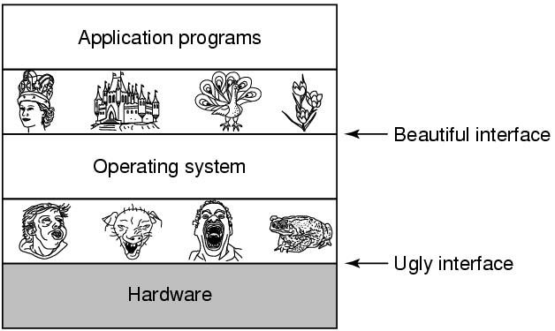
Modern view: Virtual Machine (2)

Slide 29
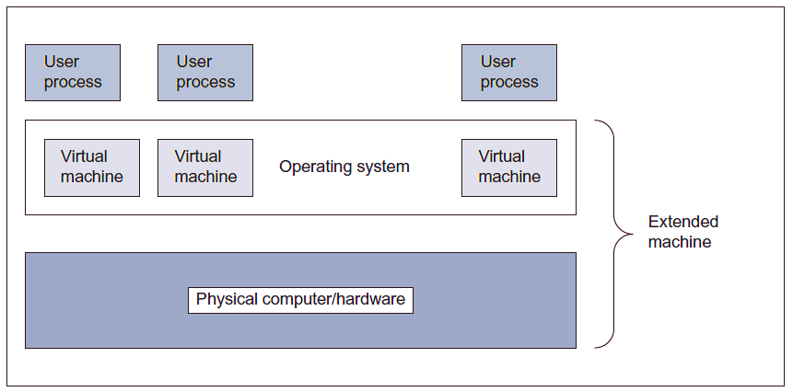
Operating system as a Virtual Machine Manager

Slide 30
THANK YOU

